Slide 1
Model Serving and Monitoring with Flask and Heroku
AISaturdays Lagos Cohort 7

Slide 2
Content
Creating the Flask Application
Tracking Changes Using Git
Deploying to Heroku

Slide 3
Creating a Flask Application

Slide 4
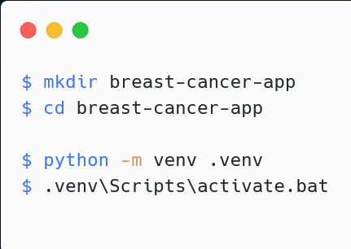
Setting up your Python App environment
The following code snippets creates a directory and a Python virtual environment.

Slide 5
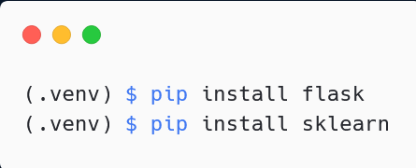
Installing Dependencies
The following snippet installs the currently known dependencies in our virtual environment. Also make sure to transfer the saved model file into the project directory.

Slide 6
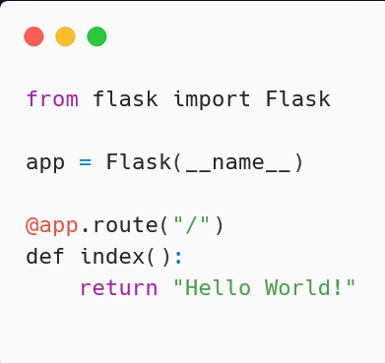
Writing the Script: The very basics

Slide 7
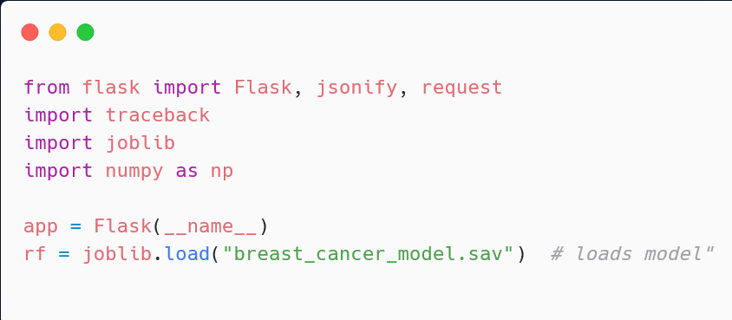

Writing the Script: Adding imports and loading model

Slide 8
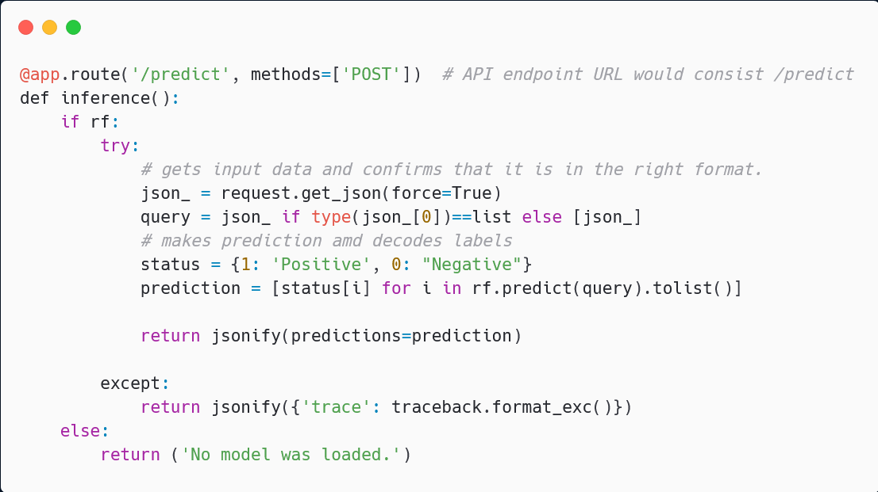
Writing the Script: Adding imports and loading model

Slide 9
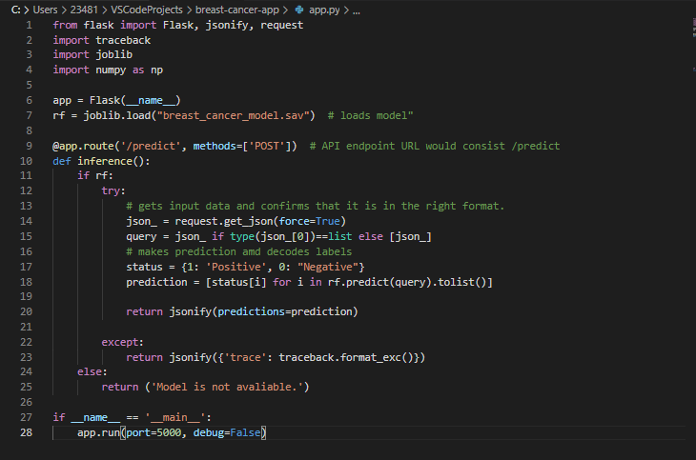

Slide 10
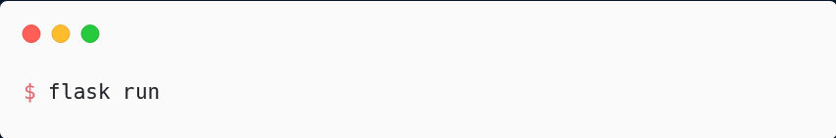
Starting the local server and testing the API
Firstly, one has to start the server and the command below helps with that.
Next up, we create a script named test.py and enter the lines of code on the next page to test the API. The Prediction should be [Negative,Positive, Positive].

Slide 11
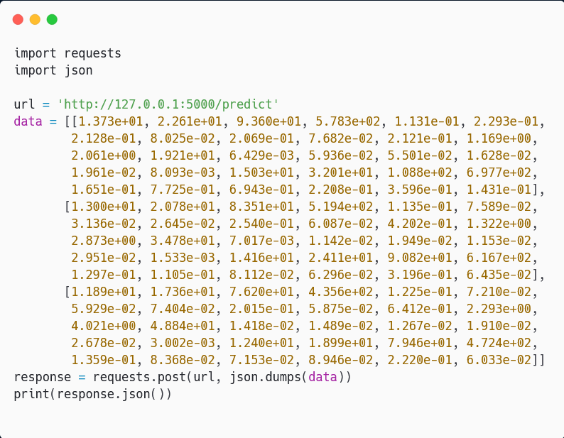

Slide 12
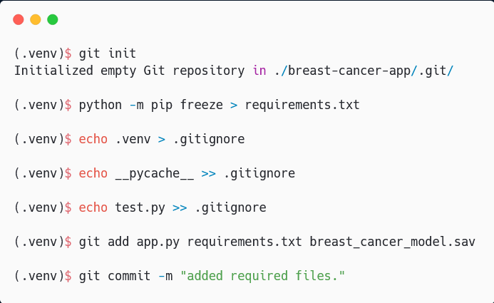
Tracking Changes Using Git
Notes:
Windows users should make sure to use the git terminal.

Slide 13
DEPLOYING TO HEROKU

Slide 14
Getting Started with Heroku
Create a free heroku account (Sign up)
Download and install the Heroku CLI Git. (The Heroku CLI)

Slide 15
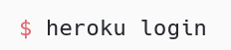
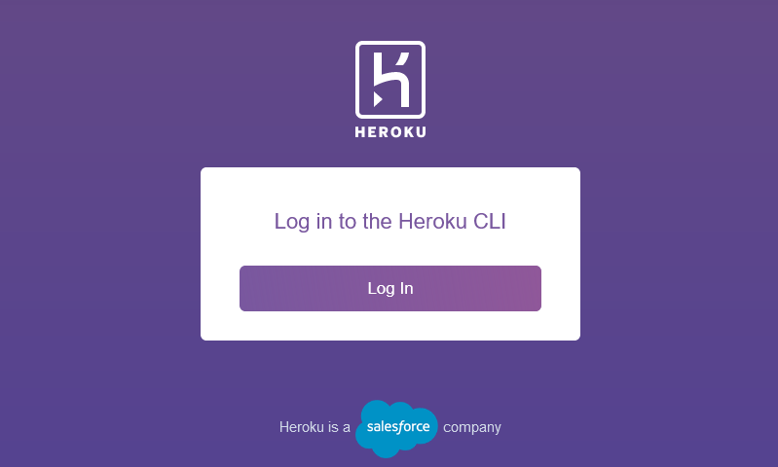
Log-in to heroku via the CLI.
Run the command below to login to heroku CLI. A browser tab opens with the image below displayed. Click “log In” and enter your credentials.

Slide 16
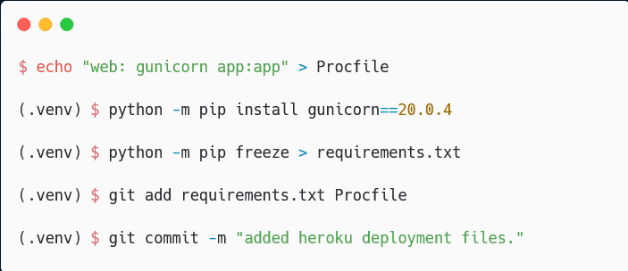
Deployment: Adding Procfile and updating repository
In your git terminal, run the following commands to create a procfile and make a commit.

Slide 17
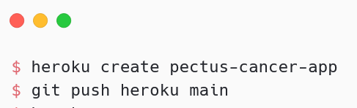
Deployment: Creating the App
The following commands creates the app and uploads the files we have locally to Heroku’s git. It then builds the app, installs requirements and voila!

Slide 18
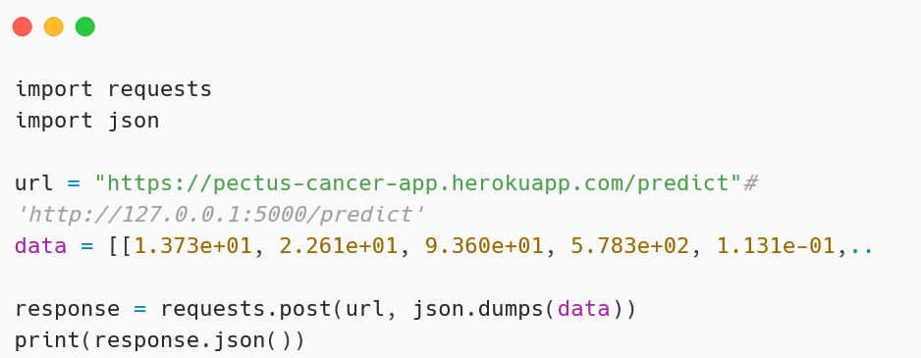
Testing the API
Modify the url variable in the test.py script and make it point to the app’s URL then run it.

Slide 19
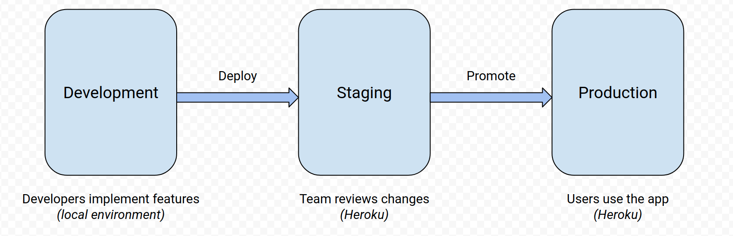
Implement a Deployment Workflow via Heroku Pipelines

Slide 20
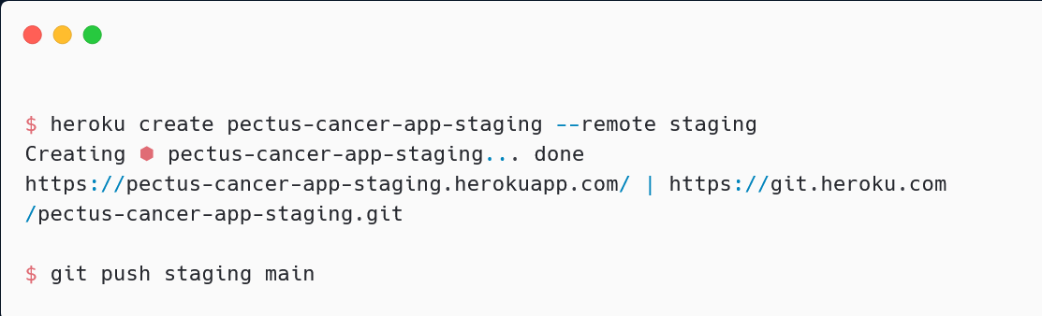
Deploying the Staging App
The following commands creates and deploys the staging app.

Slide 21
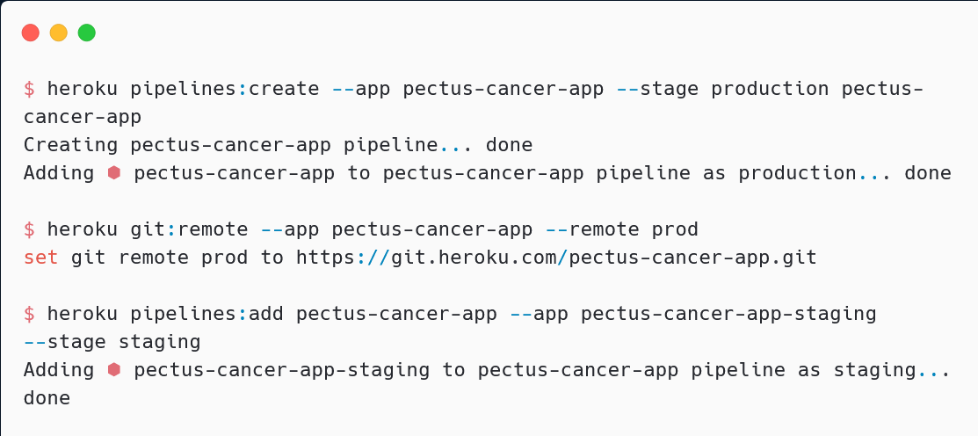
Creating and adding apps to a Pipeline

Slide 22
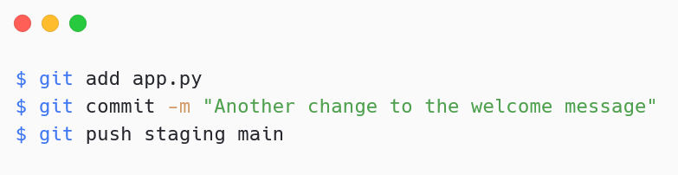
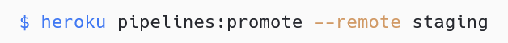
Deploying and Promoting to Staging and Production
When changes are made to the app.py script, the following lines of code can be ran via the git terminal to make a commit. This is then pushed to staging.
When this is confirmed to work well, one can then promote to production.

